Slide 1

BJIT ACADEMY
Module Title
Employee Appraisal
Project Manager
Nani Gopal Bari, Md Kishor Morol
nani.gopal@bjitgroup.com
kishor.morol@bjitgroup.com
Niazi Mahrab
niazi.mahrab@bjitgroup.com
Office_id: 11301
Software Engineer at BJIT limited
Image Placeholder
Notes:
<number>

Slide 2
Contents
Introduction
Goals
Features
Technical overview
Module descriptions and snaps

Slide 3
Project Introduction
Employee appraisal module is a component of Open HRMS suit
It helps you to utilize the best of your human resource pool

Slide 4
Goals
Appraisal module allows you to create Top Down or Bottom-up evaluation plans and give timely feedbacks and complements for accomplishments.
Employee evaluation using surveys
Three different views from managers and employee
Report print
Show in Website

Slide 5
Project Feature
Basic Level
SRS
Software Design
Use case diagram
Class diagram
Structural diagram

Slide 6
Project Feature
Advanced Level
Implementations
Advance view
Security constraints
Give different user views
Integrating with other models

Slide 7
Project Feature
Finally
Review previous works and change it if necessary
Fixing Errors
Documentations

Slide 8
Requirement Engineering
User requirement#1:
Employees are user, Employee can create employee profile, goals, reporting and can create meeting
Admin requirement#1:
Admin is superuser, admin can create employee profile, goals, appraisal, reporting and can create meeting
Manager requirement#1:
Manager can create employee profile, goals, appraisal, reporting and can create meeting

Slide 9
Technical Overview
OS: Linux,
Editor: VS code,
Front-end: XML, HTML, CSS
Back-end: Python,
Database: PostgreSQL,
Odoo version: Odoo 14 community version,
ORM: ODOO ORM

Slide 10
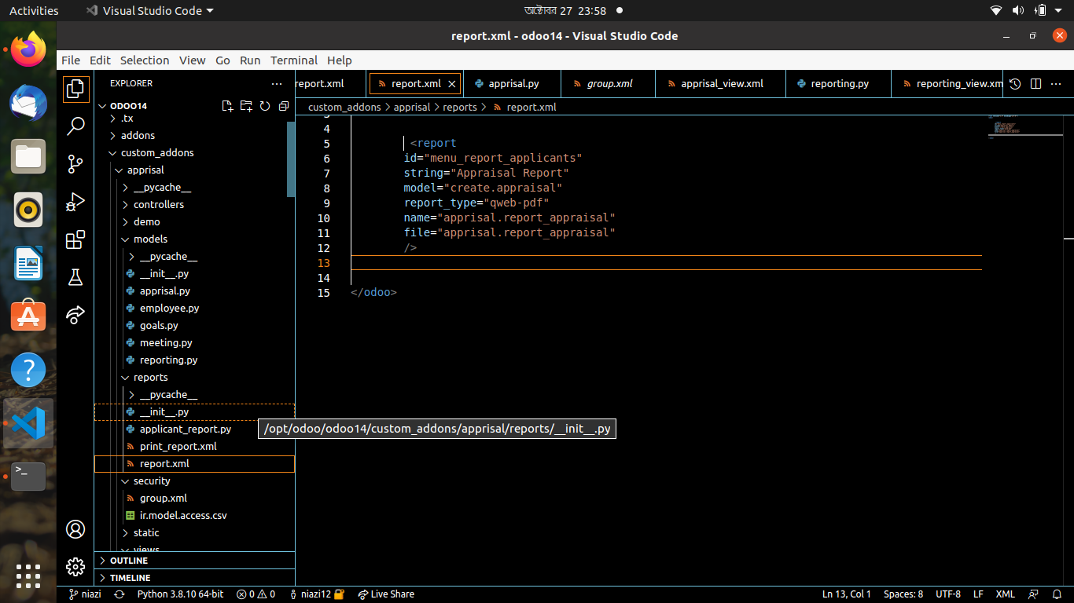
Project Structure
Python files

Slide 11
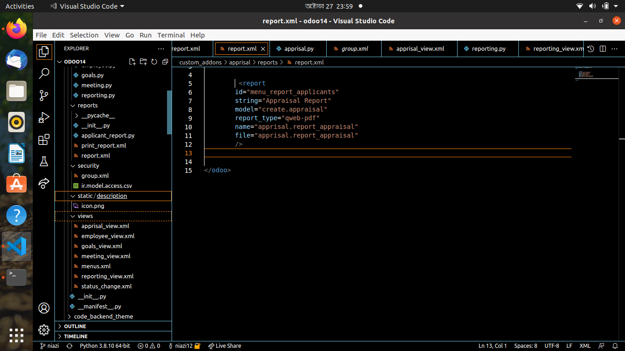
Project Structure
xml files

Slide 12
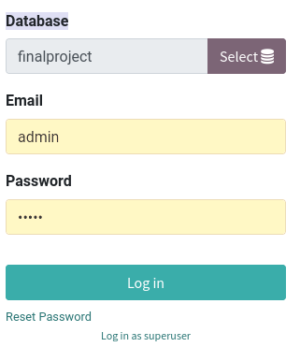
Login

Slide 13

Module

Slide 14
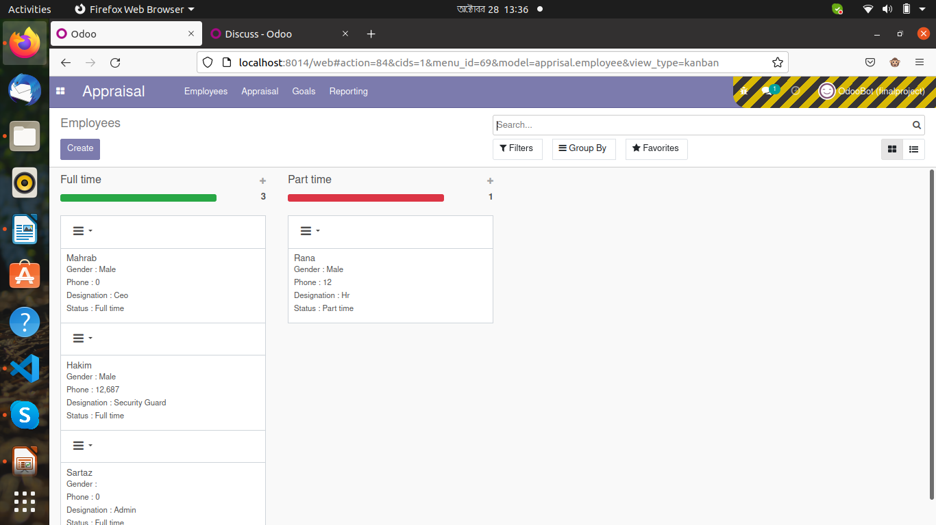
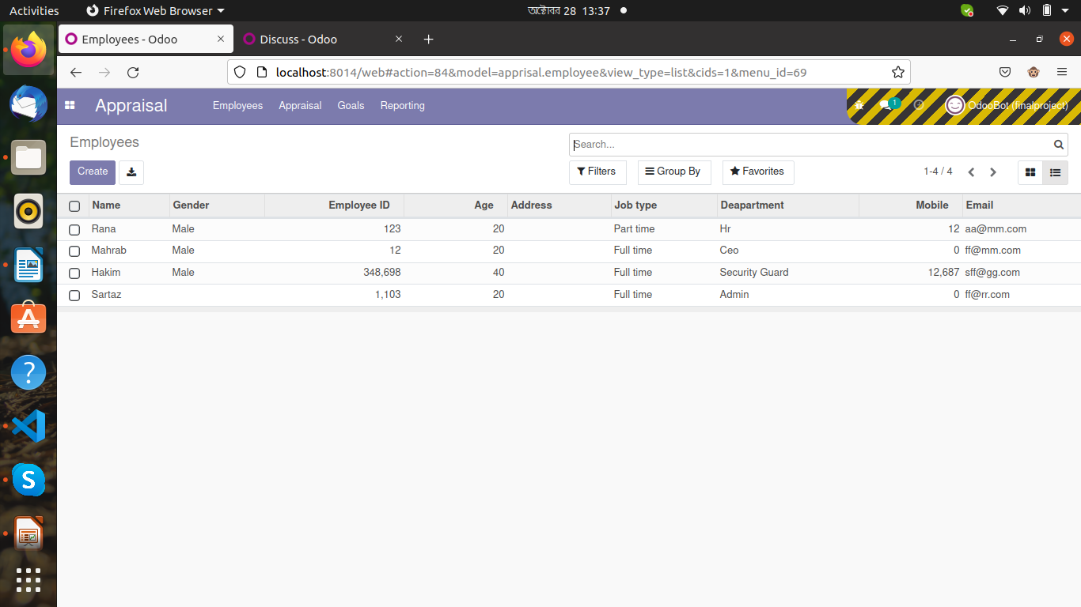
Employee View
Kanban view
List view

Slide 15
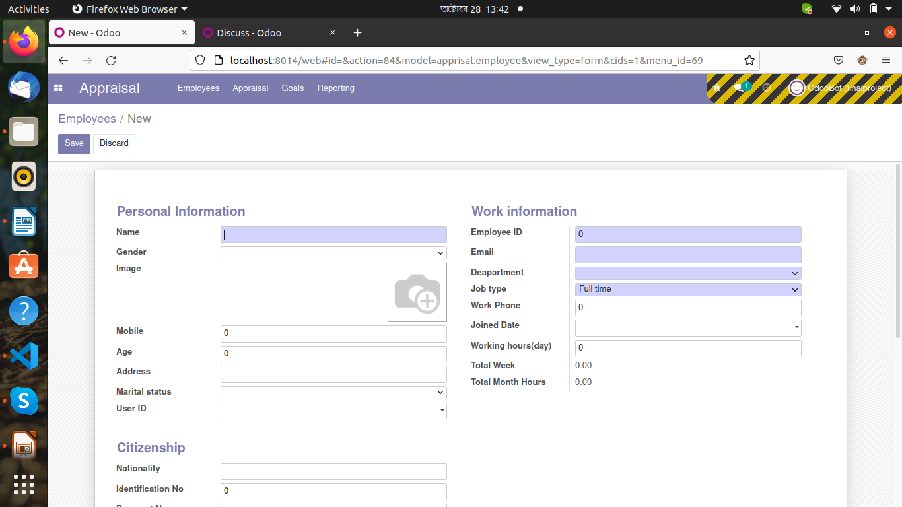
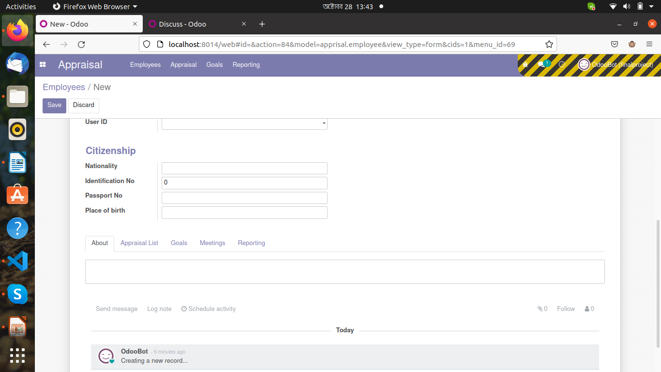
Employee form view

Slide 16
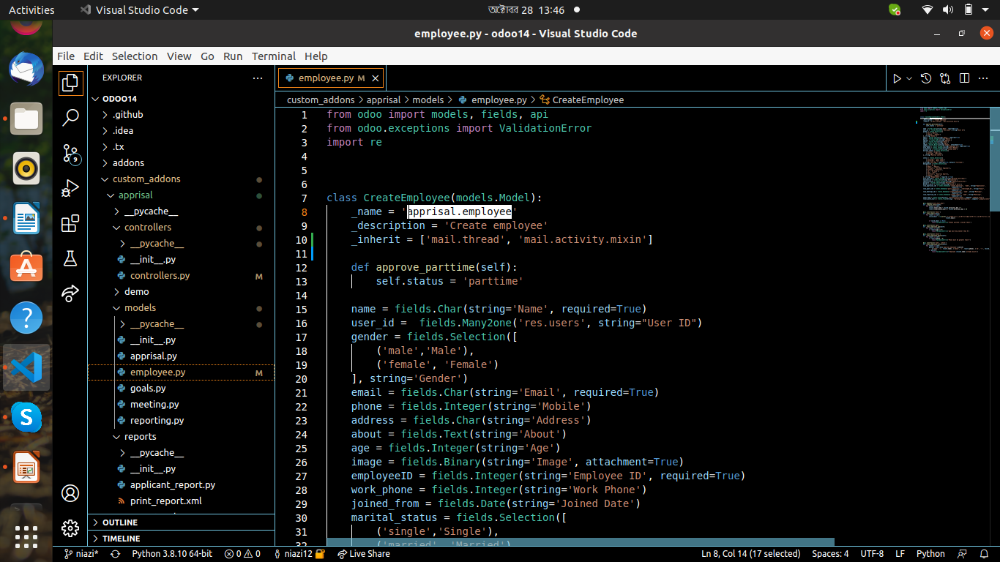
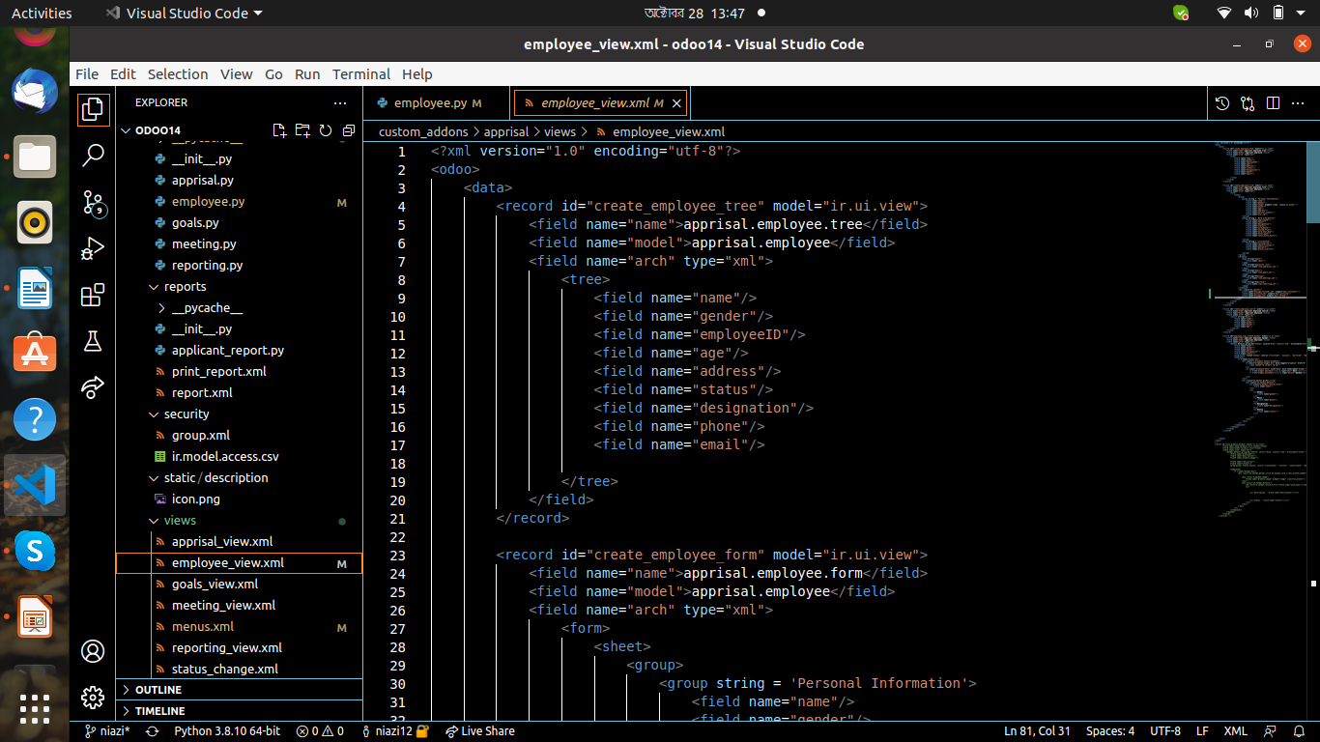
Employee model source code
Python code
XML code

Slide 17
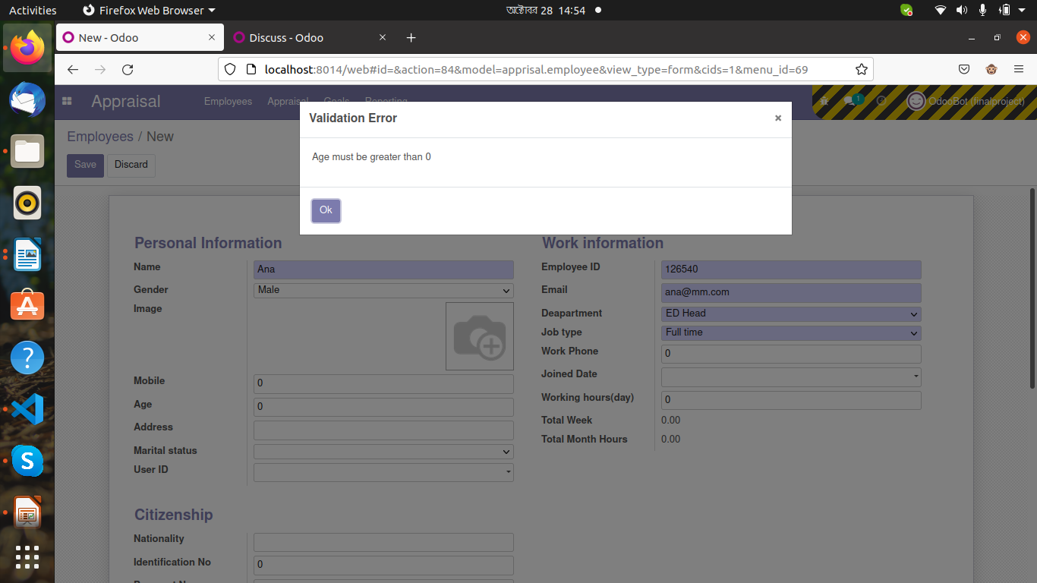
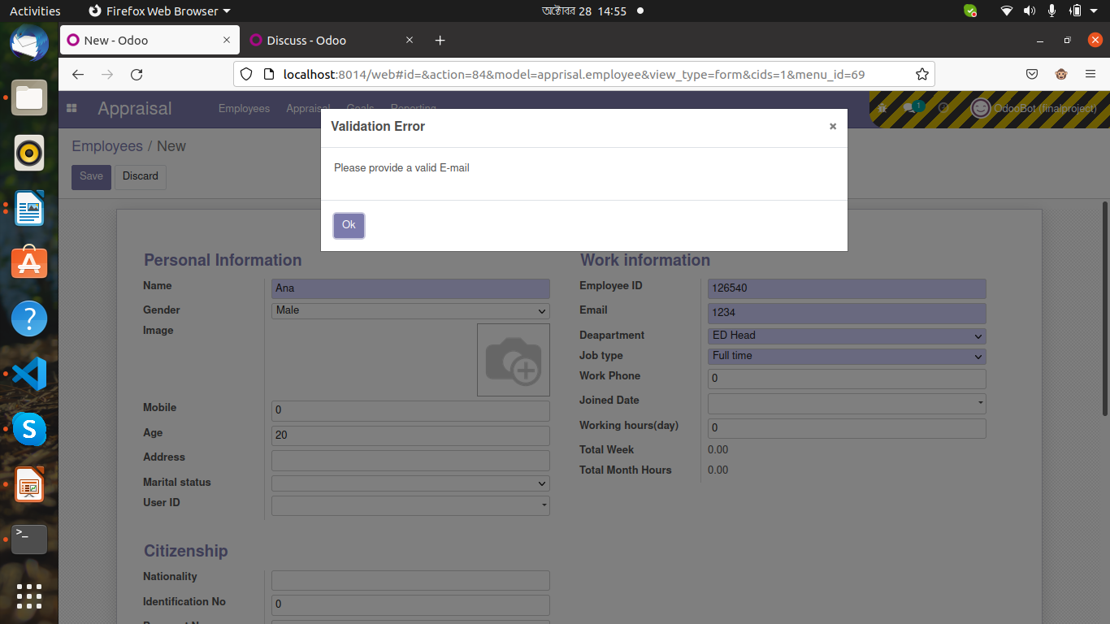
Validity in employee
Put valid age
Put valid Email

Slide 18
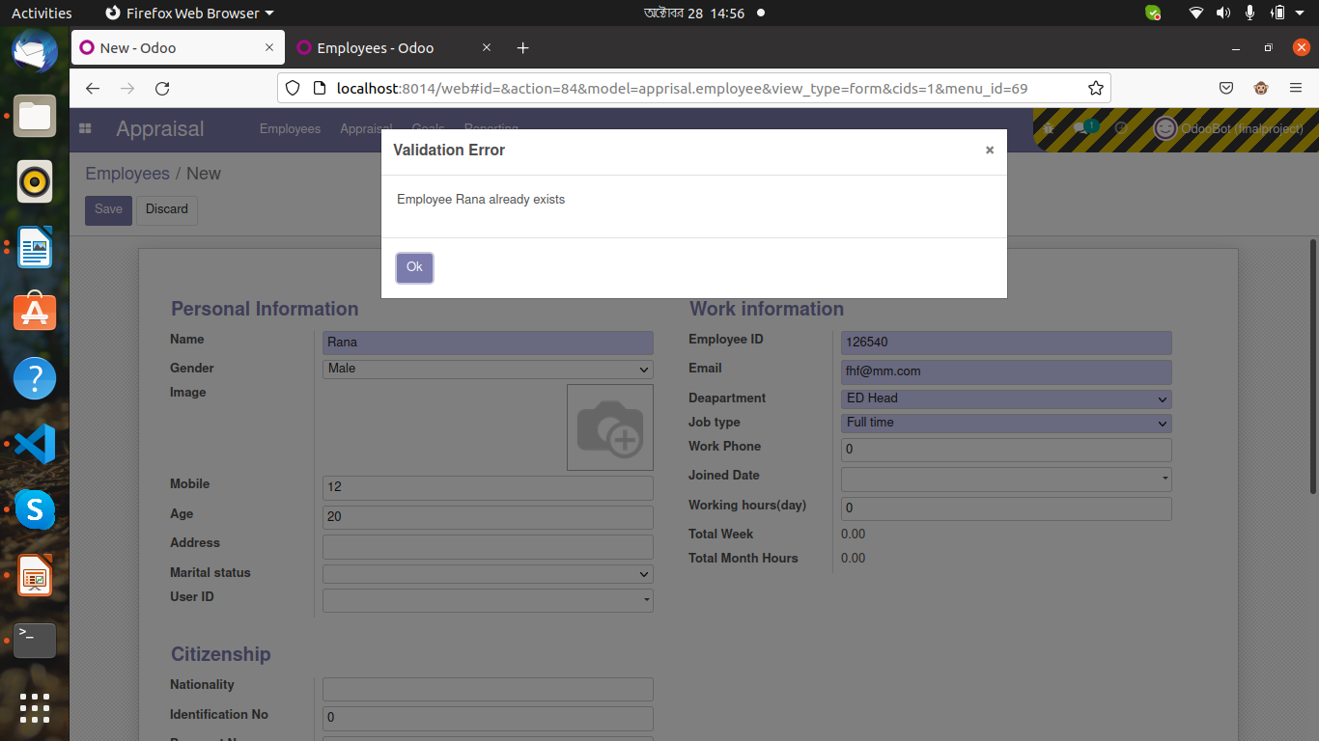
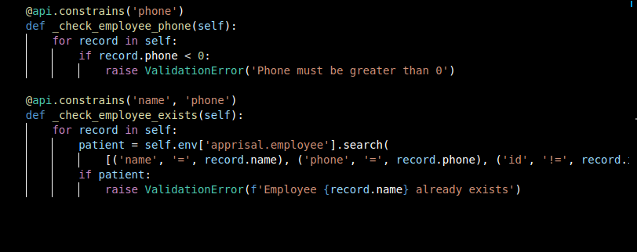
Validity and constraints source code in employee model
Check same employee by
Name and Phone

Slide 19
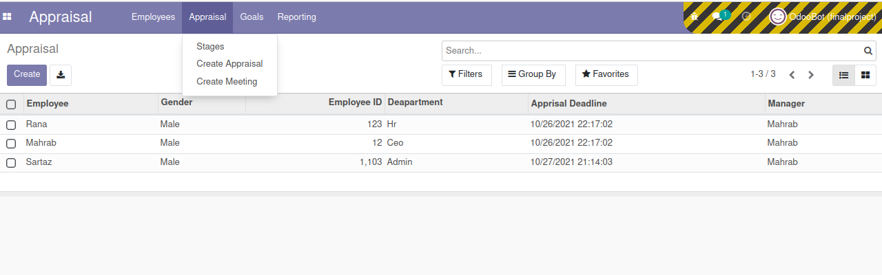
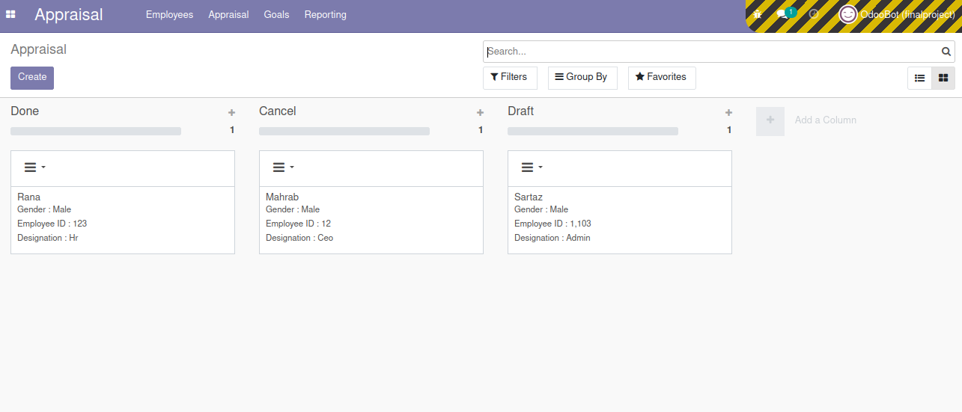
Appraisal tree, kanban view
tree
kanban

Slide 20
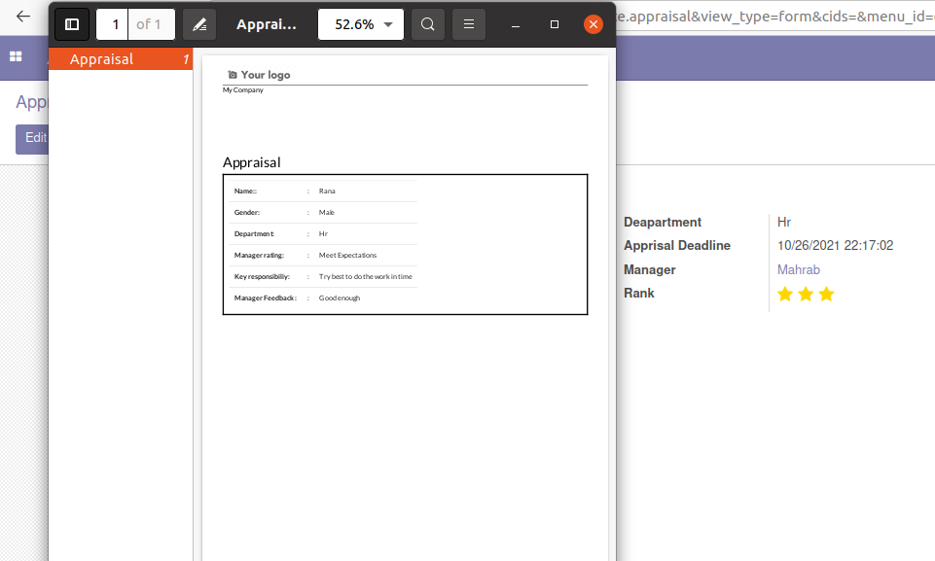
Appraisal Report

Slide 21
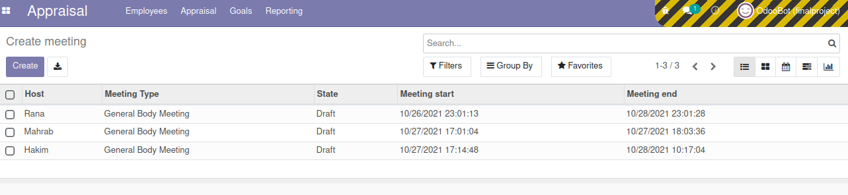
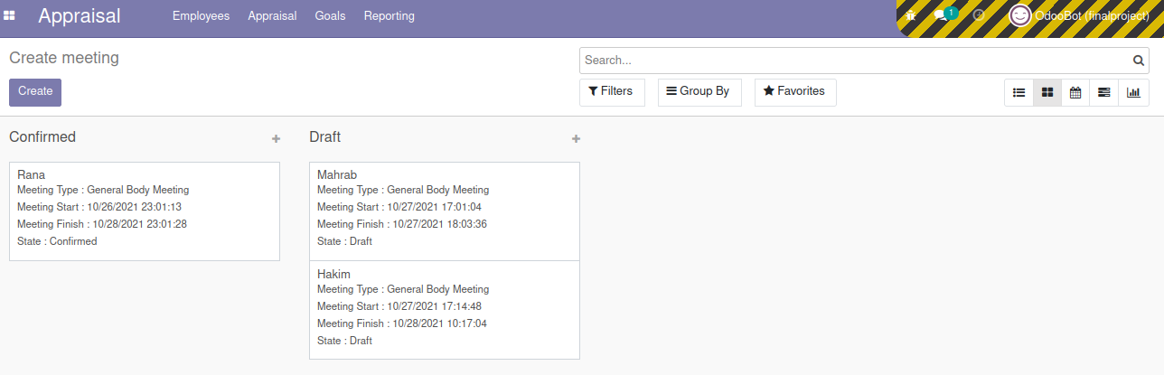
Meeting tree, kanban view
tree
kanban

Slide 22
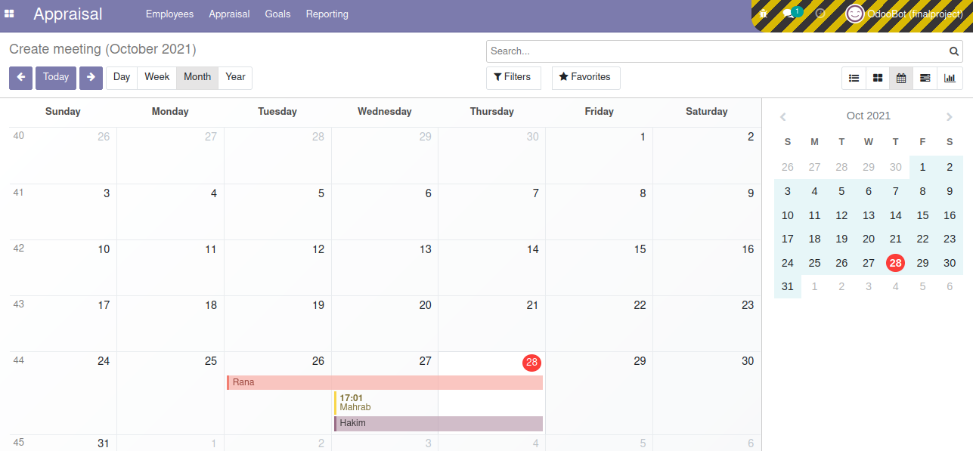
Meeting calendar view

Slide 23
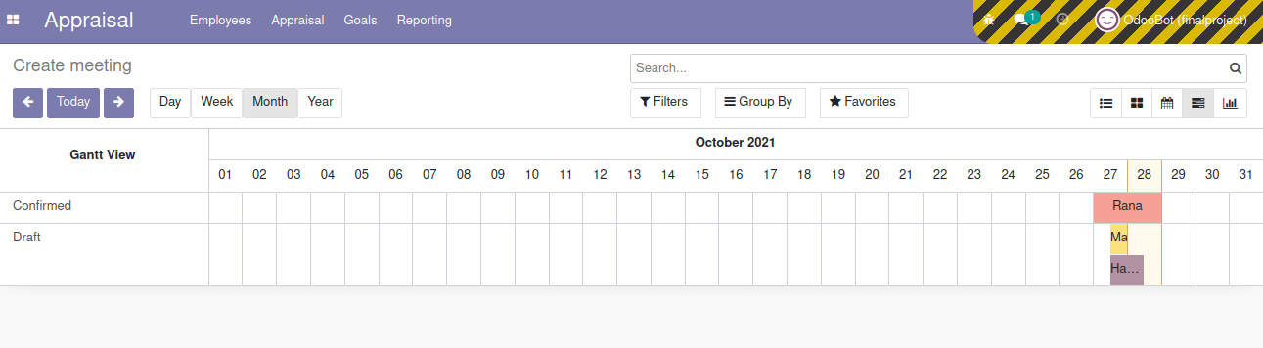
Meeting gantt view

Slide 24
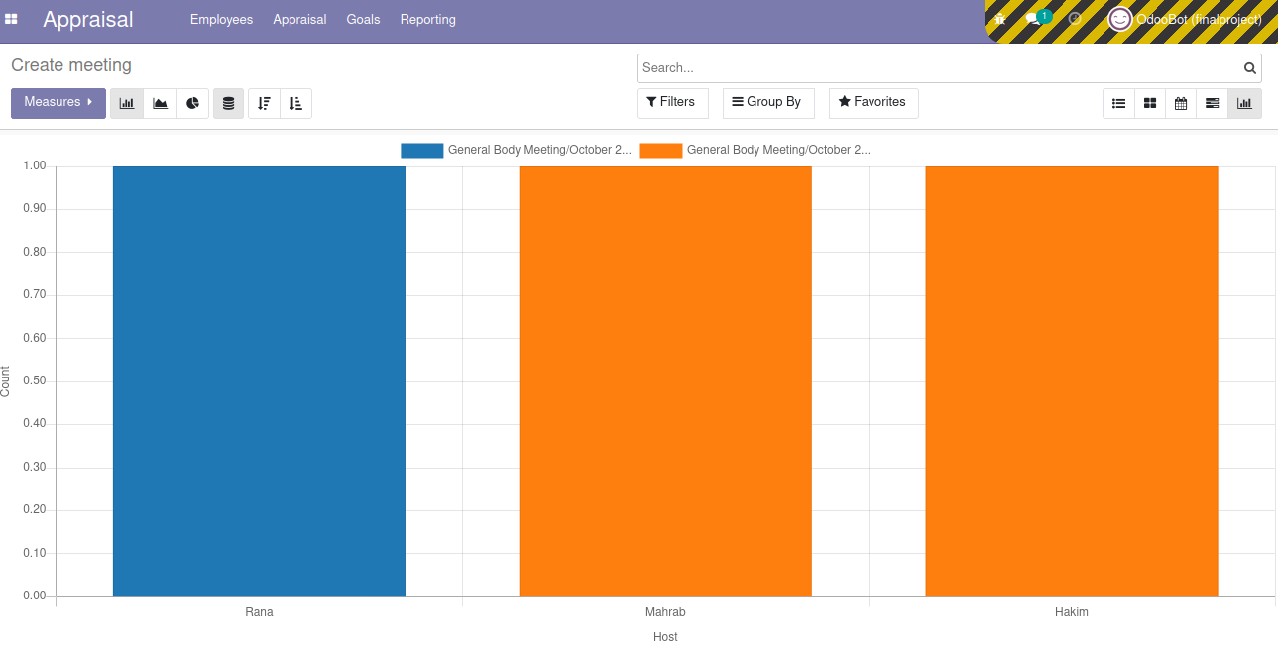
Meeting graph view

Slide 25
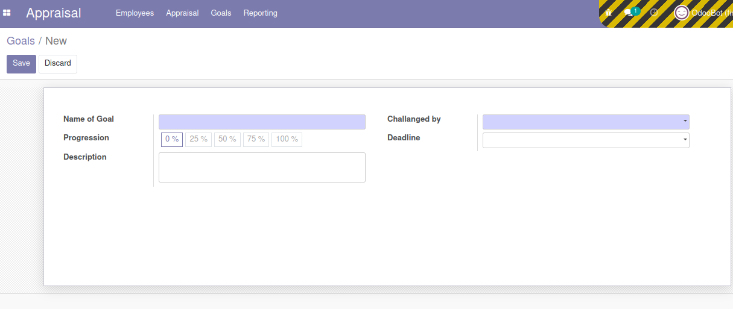
Goals form view

Slide 26
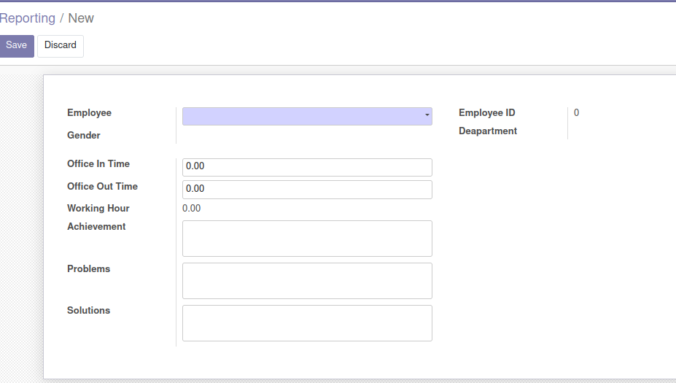
Reporting form view

Slide 27
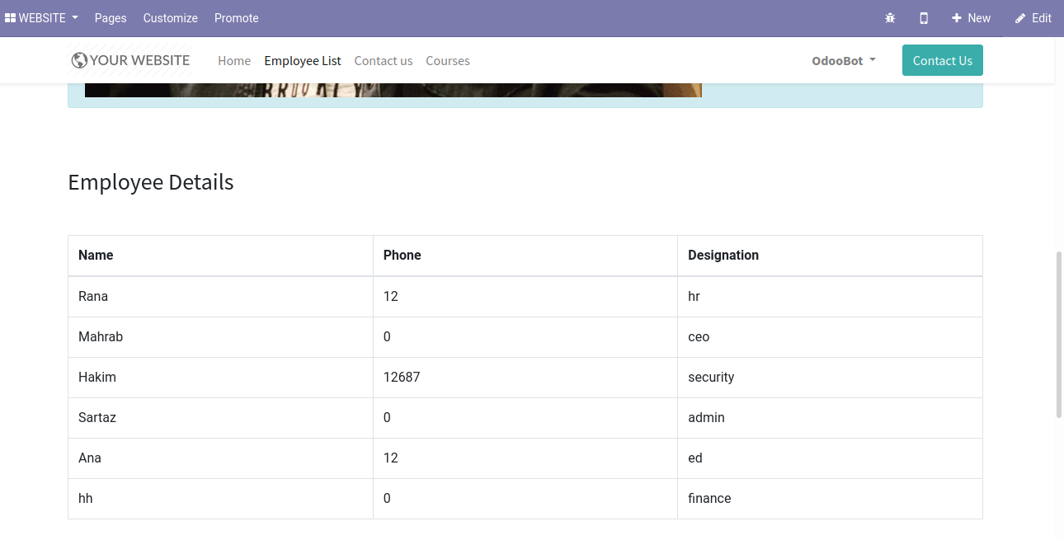
Website for appraisal employee

Slide 28
Project Submission
29th October, 2021

